Slide 2
Unit 4: GIT Version Controlling Tool (6hrs)
Introduction to Version Control
Git - A CLI, Essentials of GIT in industry
Practice with GIT: Tracking, Monitoring, Ignoring, Staging, Merging, etc.
Working with Remotes
GIT Workflows

Slide 3
Once upon a time
In a bustling software company, InnovateTechNepal, a team of developers worked on a revolutionary new application.
The team, full of brilliant minds, each had their own ideas for features, bug fixes, and improvements. But they had one big problem: coordination.

Slide 4
The CHAOS
Every developer worked on their local machines, and they shared files through email or USB drives. Every day brought new confusion:
Duplicate Files: Files were named like project_final_v2, project_final_v2_FINAL, and project_final_v2_REALLYFINAL. No one knew which was the latest version.
Overwritten Work: When two developers, Ram and Gita, worked on the same file, Gita’s work often overwrote Ram’s changes or vice versa. Frustrations grew.

Slide 5
The PROBLEM
Lost Progress: Hari, the team lead, accidentally deleted a file. Without a backup, two weeks of hard work vanished into thin air.
Endless Meetings: The team spent hours trying to settle whose changes to keep and whose to discard. Productivity dropped.

Slide 6
Enter Version Control : THE SAVIOR
One day, an experienced developer named Dammar joined the team. Dammar listened to their miseries and smiled knowingly. "Have you heard of VERSION CONTROL SYSTEMS?" he asked.
The team stared blankly. Dammar explained:

Slide 7
Enter Version Control : THE SAVIOR
"Version control is like a time machine for your project. It lets us:
Track every change made to our code.
Work on the same files without overwriting each other's progress.
Roll back to an earlier version if we mess up.
Collaborate seamlessly as a team.

Slide 8
The Transformation
Dammar set up a repository, a central place to store the project's files. He showed the team how to:
Commit changes to save their progress with meaningful messages like "Fixed login bug" or "Added new feature to dashboard."
Branch off for individual tasks, like Emma working on a new feature while Jane fixed bugs.
Merge changes to combine everyone’s contributions into a single, cohesive project.
Resolve conflicts gracefully when two people modified the same file.

Slide 9
The HAPPY ENDING
Soon, the chaos faded away:
Everyone always had the latest version of the project.
No more accidental overwrites.
No more lost work—because the repository remembered every version ever committed.
Productivity skyrocketed as the team worked together seamlessly.

Slide 10
Version Control
Version control is a system that records changes to files or a set of files over time so you can recall specific versions later.
It allows teams to manage changes to source code, documents, and other data collaboratively and systematically.
Version control is crucial in software development and other collaborative projects, where tracking changes and managing multiple contributors is essential.

Slide 11
Why Version Control
Collaboration: In team environments, multiple developers work on the same codebase. Without a system to manage changes, coordinating efforts and avoiding conflicts is challenging.
Change Tracking: It is important to know who made changes, what changes were made, and why they were made to maintain accountability and traceability.

Slide 12
Why Version Control
Backup and Recovery: Mistakes happen. Version control provides a way to recover previous versions of files or entire projects.
Parallel Development: Teams often work on new features, bug fixes, or experiments simultaneously. Version control allows this parallel development without overwriting each other's work.

Slide 13
Why Version Control
Audit and Compliance: In professional environments, documenting changes is necessary for compliance with industry regulations or standards.
Improving Productivity: By automating tasks like merging code and identifying conflicts, version control saves time and effort.

Slide 14
Types of Version Control
Local Version Control: Changes are stored on the developer’s machine.
Example: Revision control tools like RCS.
Centralized Version Control Systems (CVCS): The central server stores all versioned files, and clients access it.
Example: Subversion (SVN).
Distributed Version Control Systems (DVCS): Each user has a full copy of the repository, allowing offline work.
Example: Git, Mercurial.

Slide 15
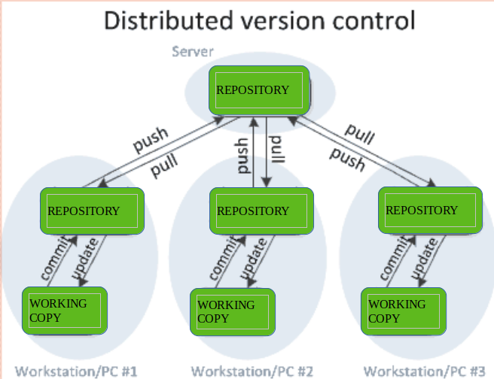
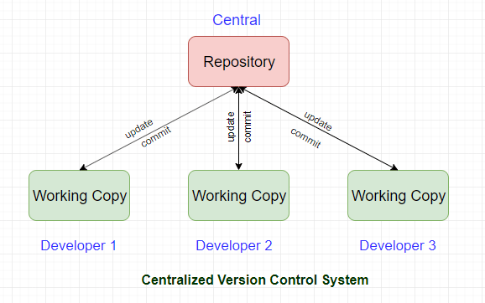
Types of Version Control

Slide 16
End of Lecture 8

Slide 17
PRACTICE WITH GIT

